Slide 1


Institute of Emerging Careers
Learn. Earn. Contribute.
Build Meaningful Presentation

Slide 2


Do you want to make the world’s best PPT presentations?

Slide 3
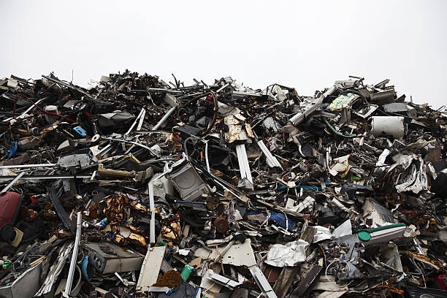
10 Billion presentations are created every year.
Did you know?
Only 5%
Are compelling and insightful.

Slide 4
We will enable you to independently make effective PowerPoint presentations

Slide 5
We will teach you to
Be in the top 5%

Slide 6
A deck is a combination of:
A story
Facts
Meaningful
visuals
What and why
of a project.

Slide 7





Presentation skills mean to focus on
All aspects of
communication
Verbal Communication
Non Verbal Communication
Impactful Content
Design
Over all
look

Slide 8
Chronological contents
Slide 1:
Introduction:
Name
Logo of company
Email address
Presented to:
Slide 2:
Project name and picture:
Slide 3 - 7
What – how – why of the project
Slide 8 - 9:
Infographics + examples:
Slide 10:
Thank you + Q&A:

Slide 9



Special focus on
Grammar
Capitalization
Font
Correct use of grammar
1 or 2 fonts, be consistent

Slide 10
Useful sentences in a presentation

Slide 11
Greetings/Assalamualaikum/
I hope all of you are well My name is _________ and I will be giving a presentation my Capstone project.
1

Slide 12
2
The project that I will be presenting on is _________.

Slide 13
3
I chose this project because..
This project is very close to my heart because..

Slide 14
4
Thank you so much for listening. If there are any questions, I shall be happy to answer them

Slide 15
5
If you do not know the answer to a question, politely tell them that you will be reaching out to them via their email address, ask for their email address and do that in 24 hours.

Slide 16
Helpful tips

Slide 17
Remember to:
Use bullets instead of paragraphs in slides
Take care of the time allotted to you for the presentation
Not go beyond 10 slides
Keep the slides simple with meaningful visuals.

Slide 18
Thanks for being with us! Questions? Tayyaba.zulfiqar@iec.edu.pk

